Slide 1

Evan You
In 2013, Evan You founded Vue, a Javascript framework funded by the community on Patreon. In 2016, Vue reached 2,000,000 downloads.
Evan You @yyx990803
Project: Vue
Location: New York City, New York
Day job: Founder at Vue Technology, LLC

Slide 2

What is Vue.js?
Vue (pronounced /vjuː/,
like view)
is a progressive framework for building user interfaces. Unlike other monolithic frameworks, Vue is designed from the ground up to be incrementally adoptable. The core library is focused on the view layer only, and is easy to pick up and integrate with other libraries or existing projects. On the other hand, Vue is also perfectly capable of powering sophisticated Single-Page Applications when used in combination with modern tooling and supporting libraries.

Slide 3
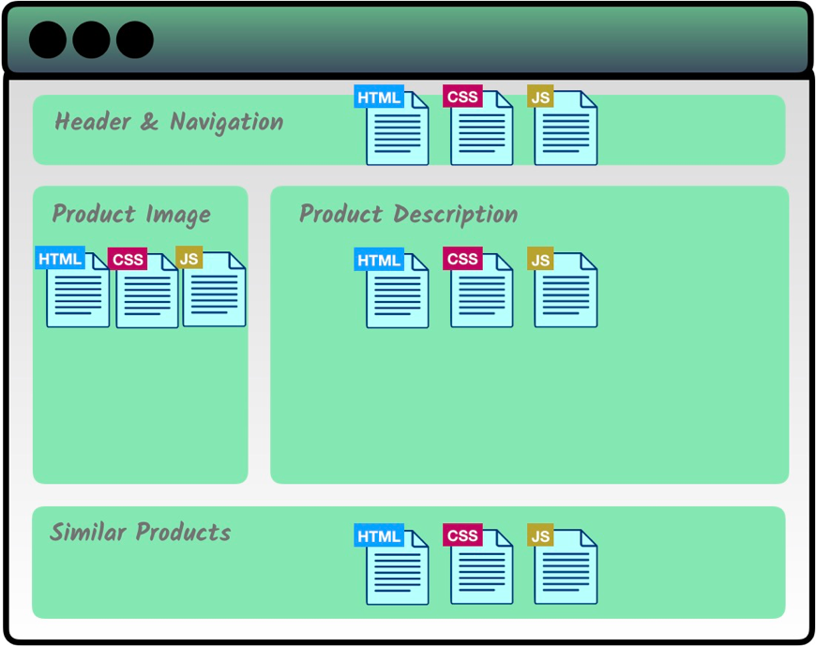
logic split -up into reusable components

Slide 4


Solutions and Uniqueness
How does Vue.js compare to the others?
ADVANTAGE IN OPTIMIZATION EFFORTS
POWERFUL,
FLEXIBLE, MODULAR
raw render/updated performance
Official support for a variety of build systems, with no restrictions
A webpack template can be setup in minutes, while also granting you access to advanced features
OFFER SIMPLE ALTERNATIVES
Render function and JSX available, but have templates as a default
Knowledge to start - HTML and JavaScript.
Non-trivial apps can be built in a day.
Syntax has similar look to AngularJS
(e.g. v-if vs ng-if)
Easier to progressively migrate existing applications

